Slide 1
LAVEA: Latency-aware Video Analytics on Edge Computing
Platform
Presentation by Jonathan Schall

Slide 2
Introduction: Reasoning for Research
Reason for all edge computing research: lots of data generated at the edge of the network
Video analytics can require massive data to be processed and can require powerful processing power
Additionally, there are many applications where video analytics are time sensitive, such as driverless cars or AR/VR applications

Slide 3
Introduction: Public Safety Use Case Example
Video surveillance is extremely important in public safety nowadays
Most public safety scenarios need the quickest response time
Difficult to run video analysis on Iot devices
An edge computing solution can provide low latency/high bandwidth and provide the quickest response

Slide 4
Introduction: Solutions to the Problem
Uploading to the Cloud - impossible for time sensitive data
Potentially use combination of mobile and cloud computing - still concerns regarding bandwidth
Cloudlet - Intermediate server between mobile devices and cloud, using VMs
LAVEA - Proposed solution: serverless using OS-virtualization

Slide 5

Serverless???
Do edge/cloud computing without managing edge/cloud instances
Instead uses containers to manage all necessary scripts and executables
Easier to deploy and use
Move away from VMs and instead use Docker containers

Slide 6
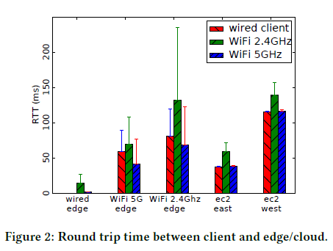
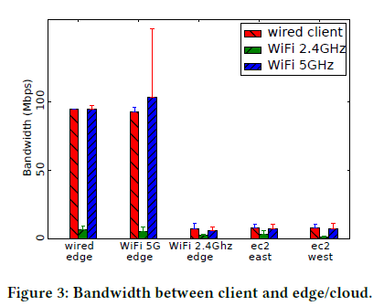
Network Performance Measurements

Slide 7
System Concepts
Main goal is for low latency, flexibility, and offloading to the edge first
Edge-front - node attached to the base station
Profiler Service - collects device performance information. Has a profiler phase for every new type of device (is it necessary?)
Monitoring Service - constantly monitors runtime and information on clients and edge nodes. Need to always know condition of network and nodes
Offloading Service - Client sends information about tasks to server, which decides which tasks should be offloaded

Slide 8
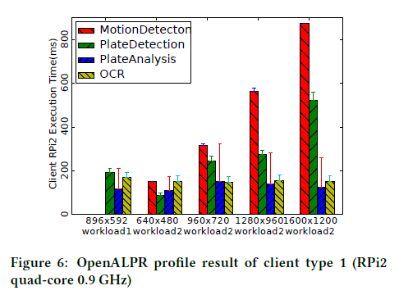
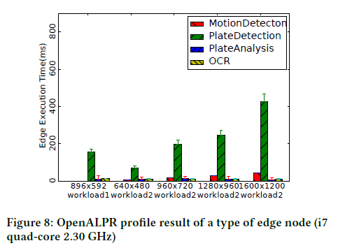
Necessity for Computation Offloading

Slide 9
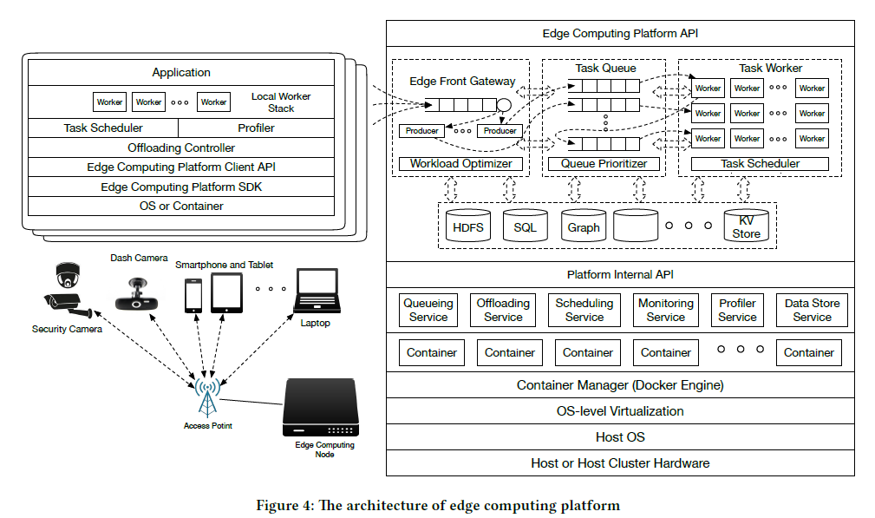
System Overview

Slide 10
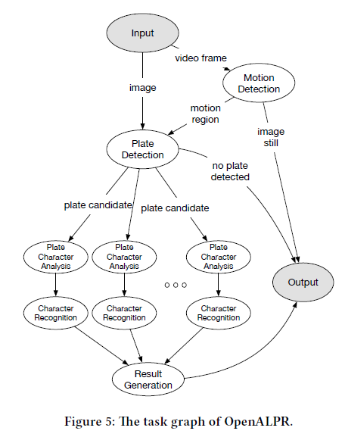
The Optimization Problem
There are a number of clients connected to a single edge server
We can model the tasks using a Directed Acyclic Graph (DAG)
Aim is to minimize job finish time
All the equations used to find bandwidth, processor power, network delay, etc. is in the paper

Slide 11
Optimizations
Johnson’s Rule for task scheduling (reduces idle time and time to complete all jobs when there are 2 stages)
Sometimes need to order tasks inside a grouping as some tasks are dependant on others
Can adjust resolution to have mix of speed and accuracy
Can offload to other edge nodes if they are favored for the task

Slide 12
Three Task Placement Schemes
Want to collaborate with nearby edge nodes when the edge-front node is overwhelmed
Potential placement schemes that can be scalable and lightweight while also efficiently reducing the workload on the front-edge node
Shortest Transmission Time First (STTF)
Shortest Queue Length First (SQLF)
Shortest Scheduling Latency First (SSLF)

Slide 13
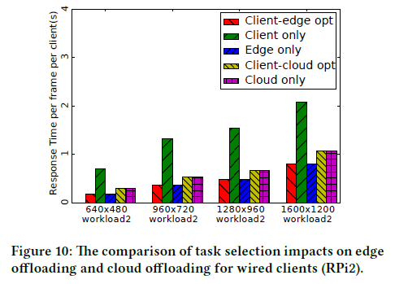
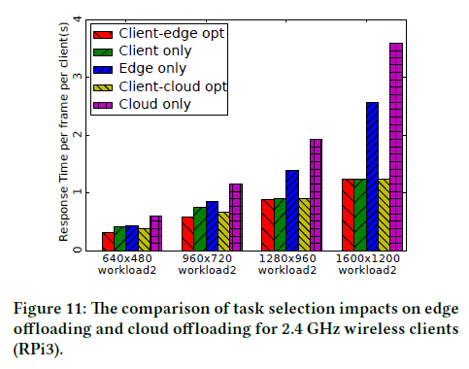
Overall Speed Increases

Slide 14

Missing Data
Many clients realistically will run as a 5 GHz wireless client
Shouldn’t assume similar results - remember figure 2 and 3

Slide 15
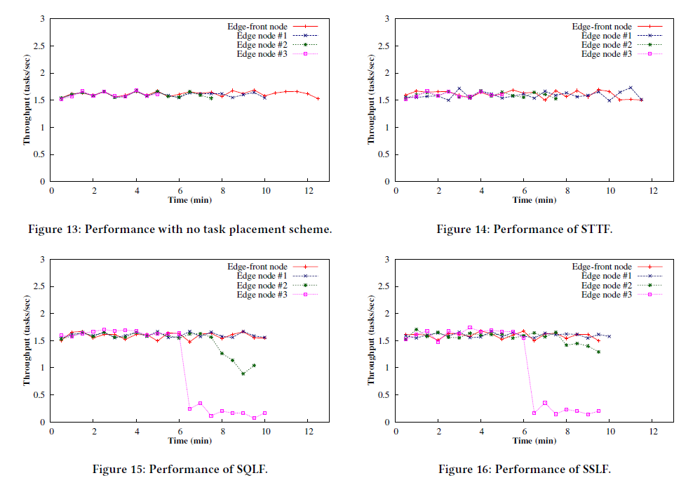
Data on Task Placement Schemes
SSLF considers both transition and wait time

Slide 16
Conclusions
One of the first edge solutions proposed to specifically handle video processing
Data showed speed improvements when compared to both client only and client-cloud solutions
Assumptions of wired connections for both edge and client nodes may not be realistic, limiting the potential use of the system and data
A lot of other assumptions and issues that limit useability
Opens up for more research on edge solutions to time sensitive video processing

Slide 17
Discussion
As this is an early paper on edge computing for video analytics, there are some areas not addressed with the LAVEA solution. Should they have been included or was it acceptable to keep them out?
Security of the system
When things don’t go as planned

